Slide 1
Java Basics
Università di Modena e Reggio Emilia
Prof. Nicola Bicocchi (nicola.bicocchi@unimore.it)

Slide 2
Building and running

Slide 3
Timeline
1991: SUN develops a language for cable TV boxes
1996: Java 1 (Netscape browser supports Java, popularity begins)
2005: Java 5 (major enhancements)
2014: Java 8 LTS (support until 2022)
2018: Java 11 LTS (support until 2023)
-- 6 months release cycle begins --
2019: Java 12, Java 13
2020: Java 14, Java 15
2021: Java 16, Java 17 LTS (support until 2026)
https://en.wikipedia.org/wiki/Java_version_history

Slide 4
JDK Enhancement Proposal
The JDK Enhancement Proposal (or JEP) is a process drafted by Oracle Corporation for collecting proposals for enhancements to the Java Development Kit and OpenJDK.
JEPs serve as the long-term Roadmap for JDK Release Projects and related efforts.
The JEP process is not intended to replace the Java Community Process, which is still required to approve changes in the Java API or language but rather to allow for OpenJDK committers to work more informally before becoming a formal Java Specification Request.
See https://openjdk.java.net/jeps

Slide 5
Features
Portable
Write once, run everywhere
Translated to bytecode
Pure object-oriented language
Statically typed
Exceptions as a pervasive mechanism
Shares syntax elements w/ C++ (reduced learning curve)
Garbage collection

Slide 6
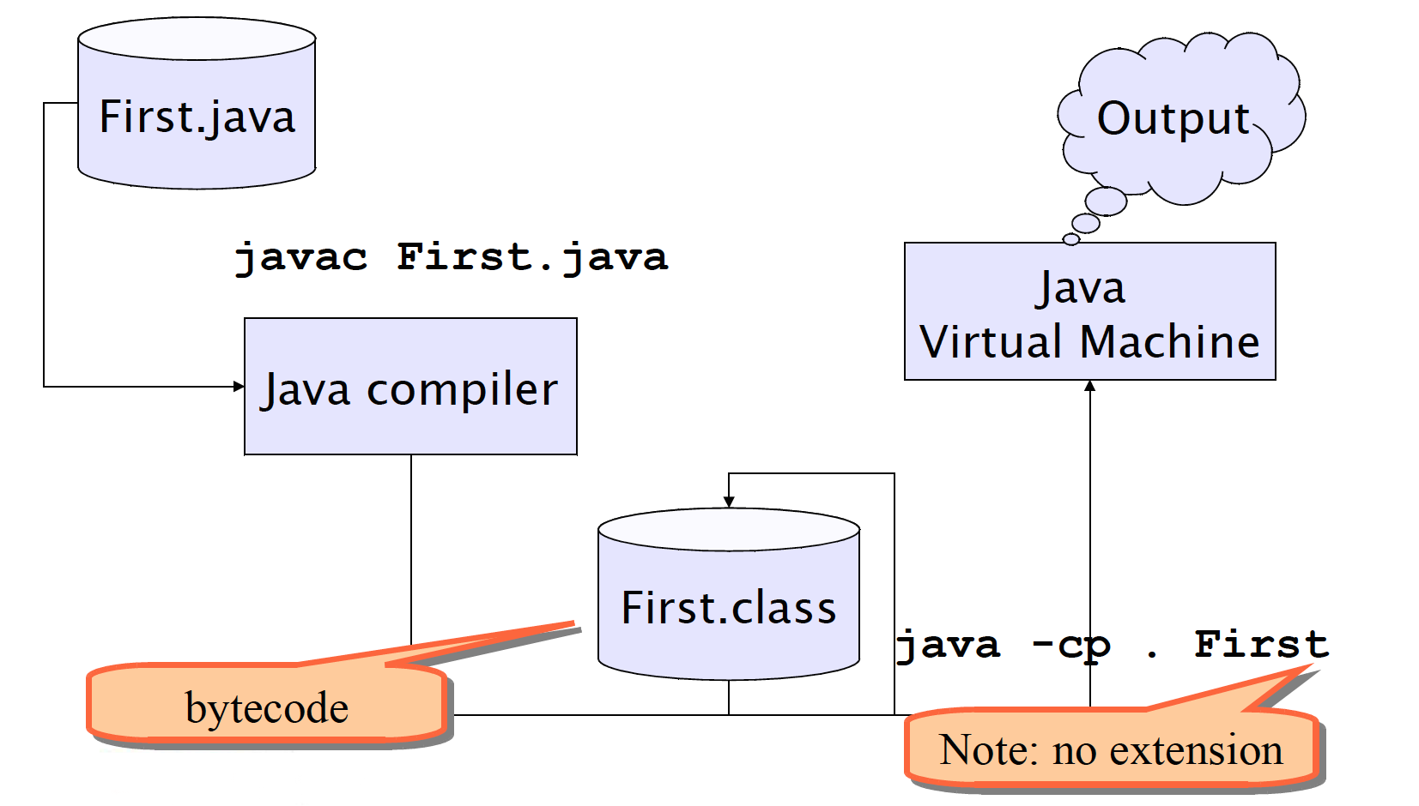
Building and running

Slide 7
Building and running
$ cd ooprogramming/java/code/src/main/java/oop/basics/
$ javac ArraysUtils.java
(builds ArrayUtils.class. Unsuitable for large projects. Gradle uses build/ dir)
$ cd ooprogramming/java/code/build/classes/java/main
$ java -cp . oop.basics.ArraysUtils
v1 = [8, 8, 8, 8, 8, 8, 8, 8]
v1 = [79, 80, 70, 2, 86, 69, 32, 70]
v1 = [2, 32, 69, 70, 70, 79, 80, 86]
v2 = [2, 32, 69, 70, 70, 0, 0, 0]
$ javap -cp . -verbose oop.basics.ArraysUtils | grep major
major version: 61
(see https://en.wikipedia.org/wiki/Java_class_file#General_layout)

Slide 8
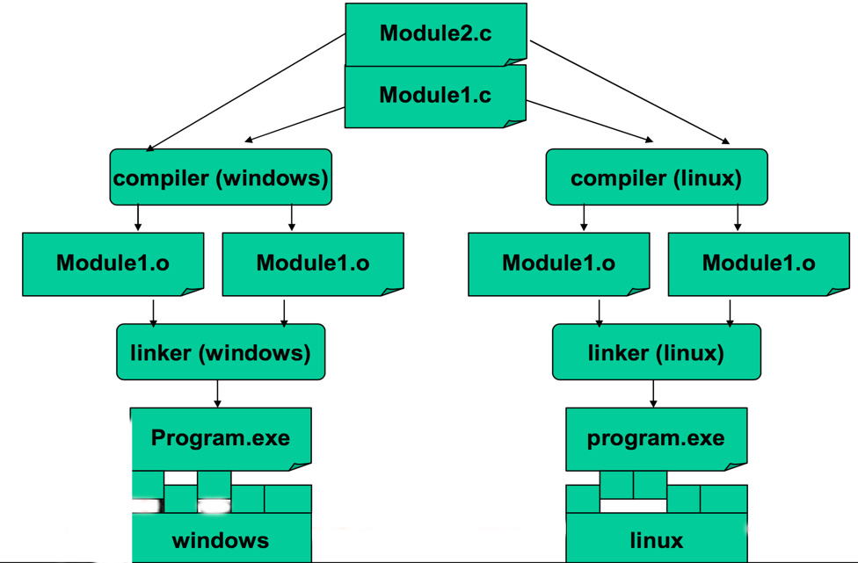
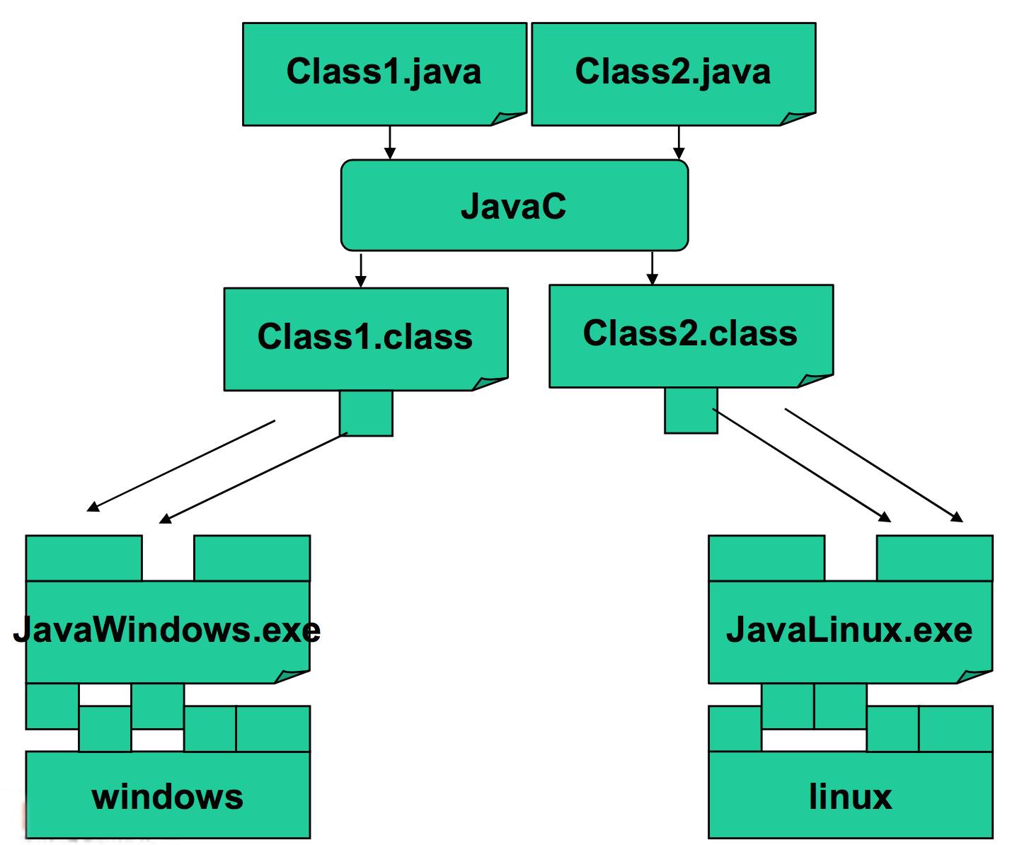
Compiled vs Interpreted

Slide 9
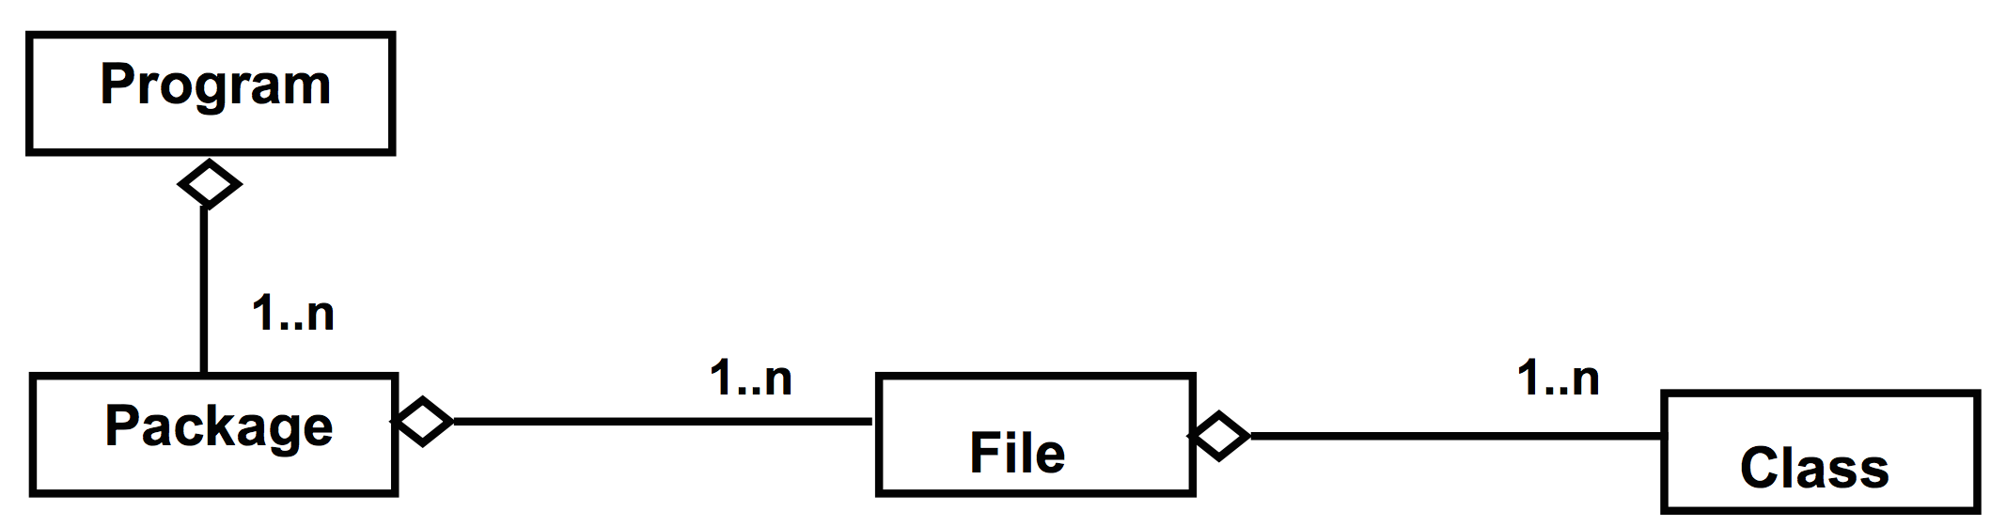
Program, files and classes
A program is made of one or more packages, containing one or more files
A file contains one public class and, optionally, multiple private classes. The file name must be equal to the public class name.

Slide 10
public static void main(String[] args)
In Java there are no functions, but only methods within classes
The execution of a Java program starts from a special method:
public static void main(String[] args) {
…
}

Slide 11
IntelliJ Idea

Slide 12
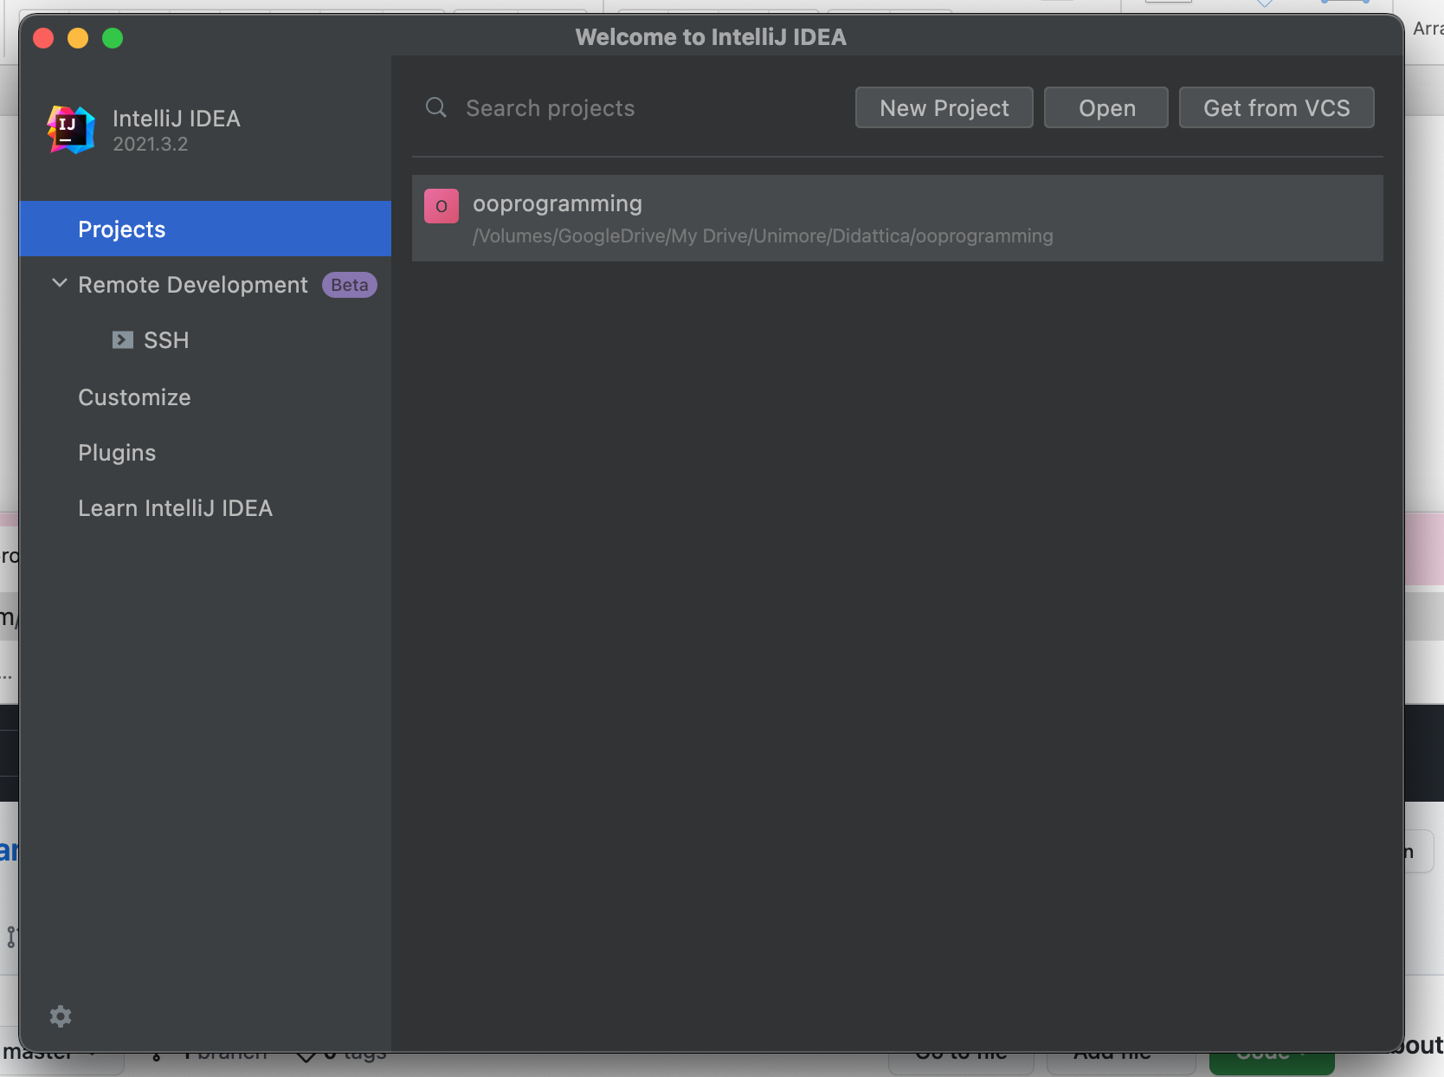
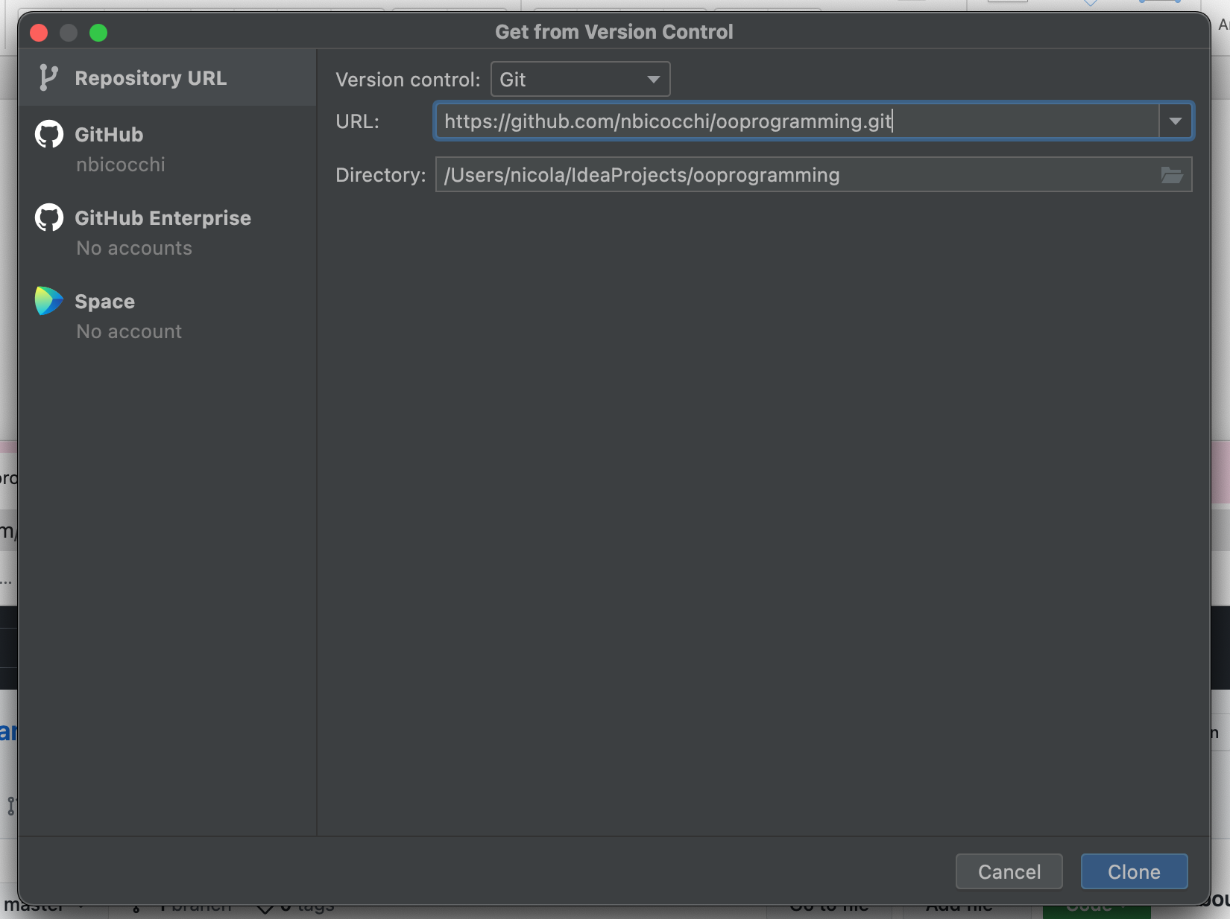
Welcome to IntelliJ Idea

Slide 13
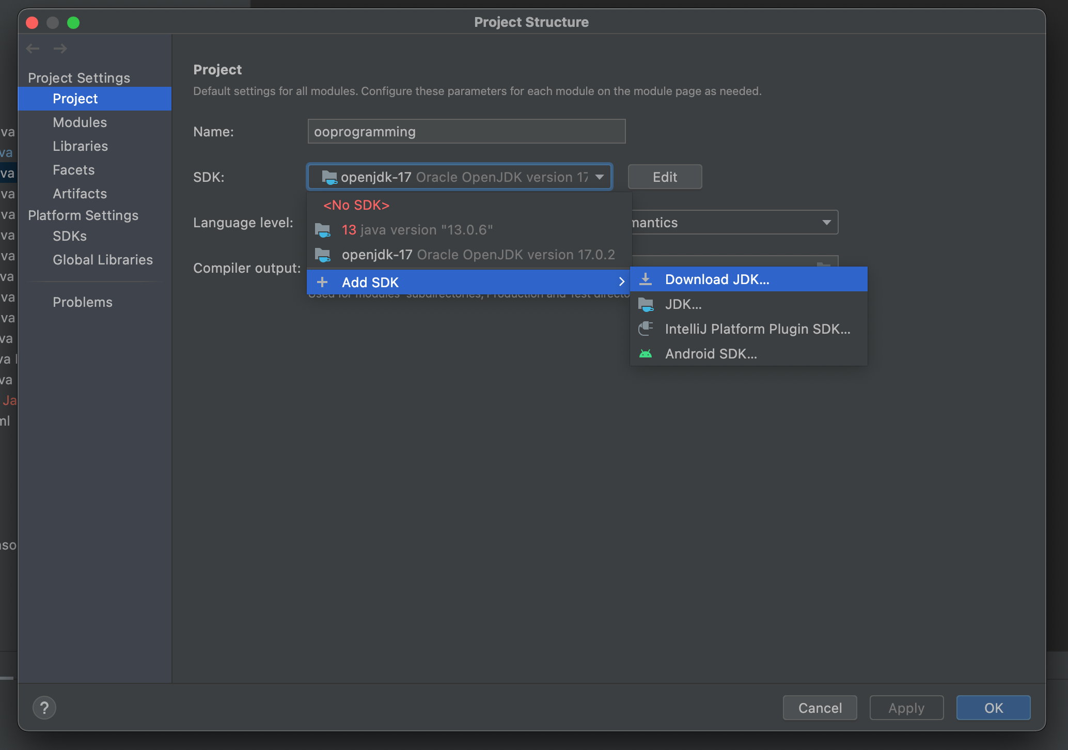
File -> Project Structure
Download openjdk-17
Select SDK: openjdk-17

Slide 14
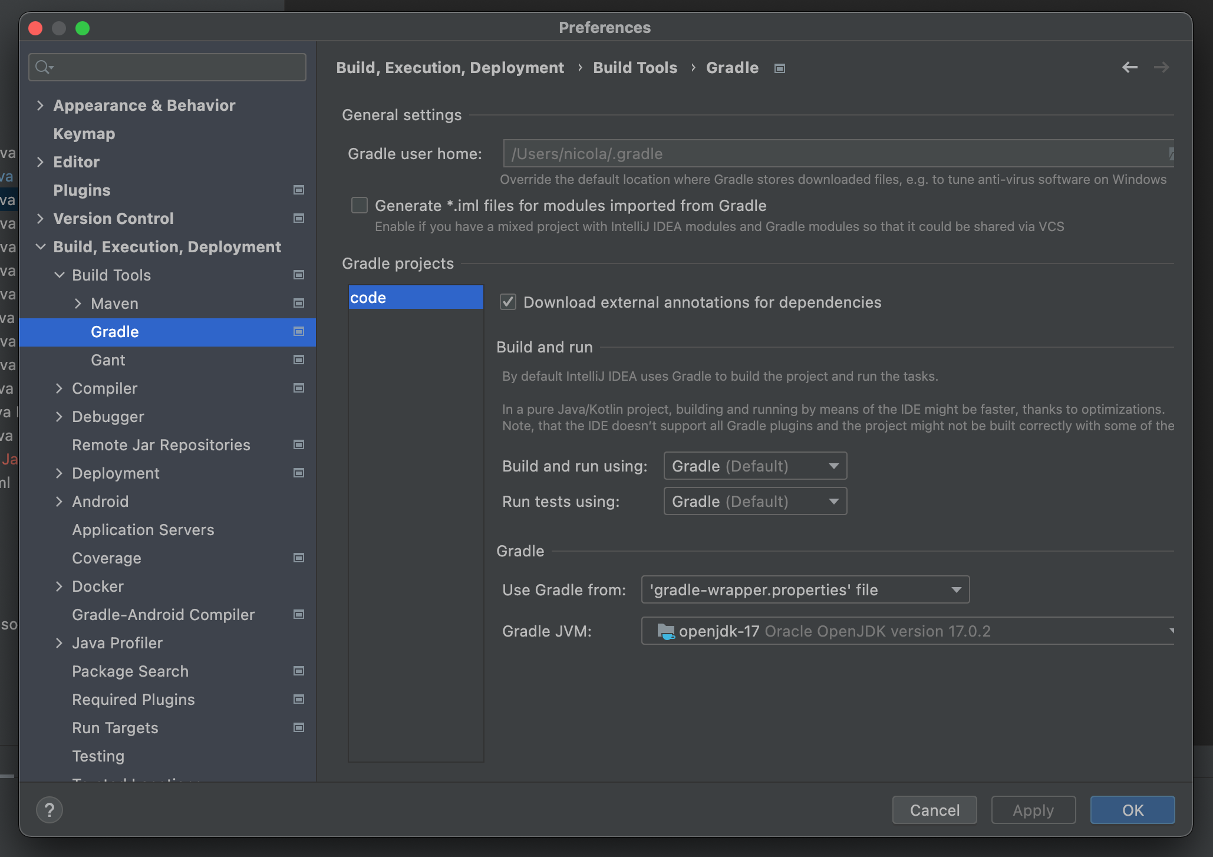
Preferences -> Build, Execution, Deployment -> Gradle
Build and run using: Gradle
Run tests using: Gradle
Gradle JVM: openjdk-17

Slide 15
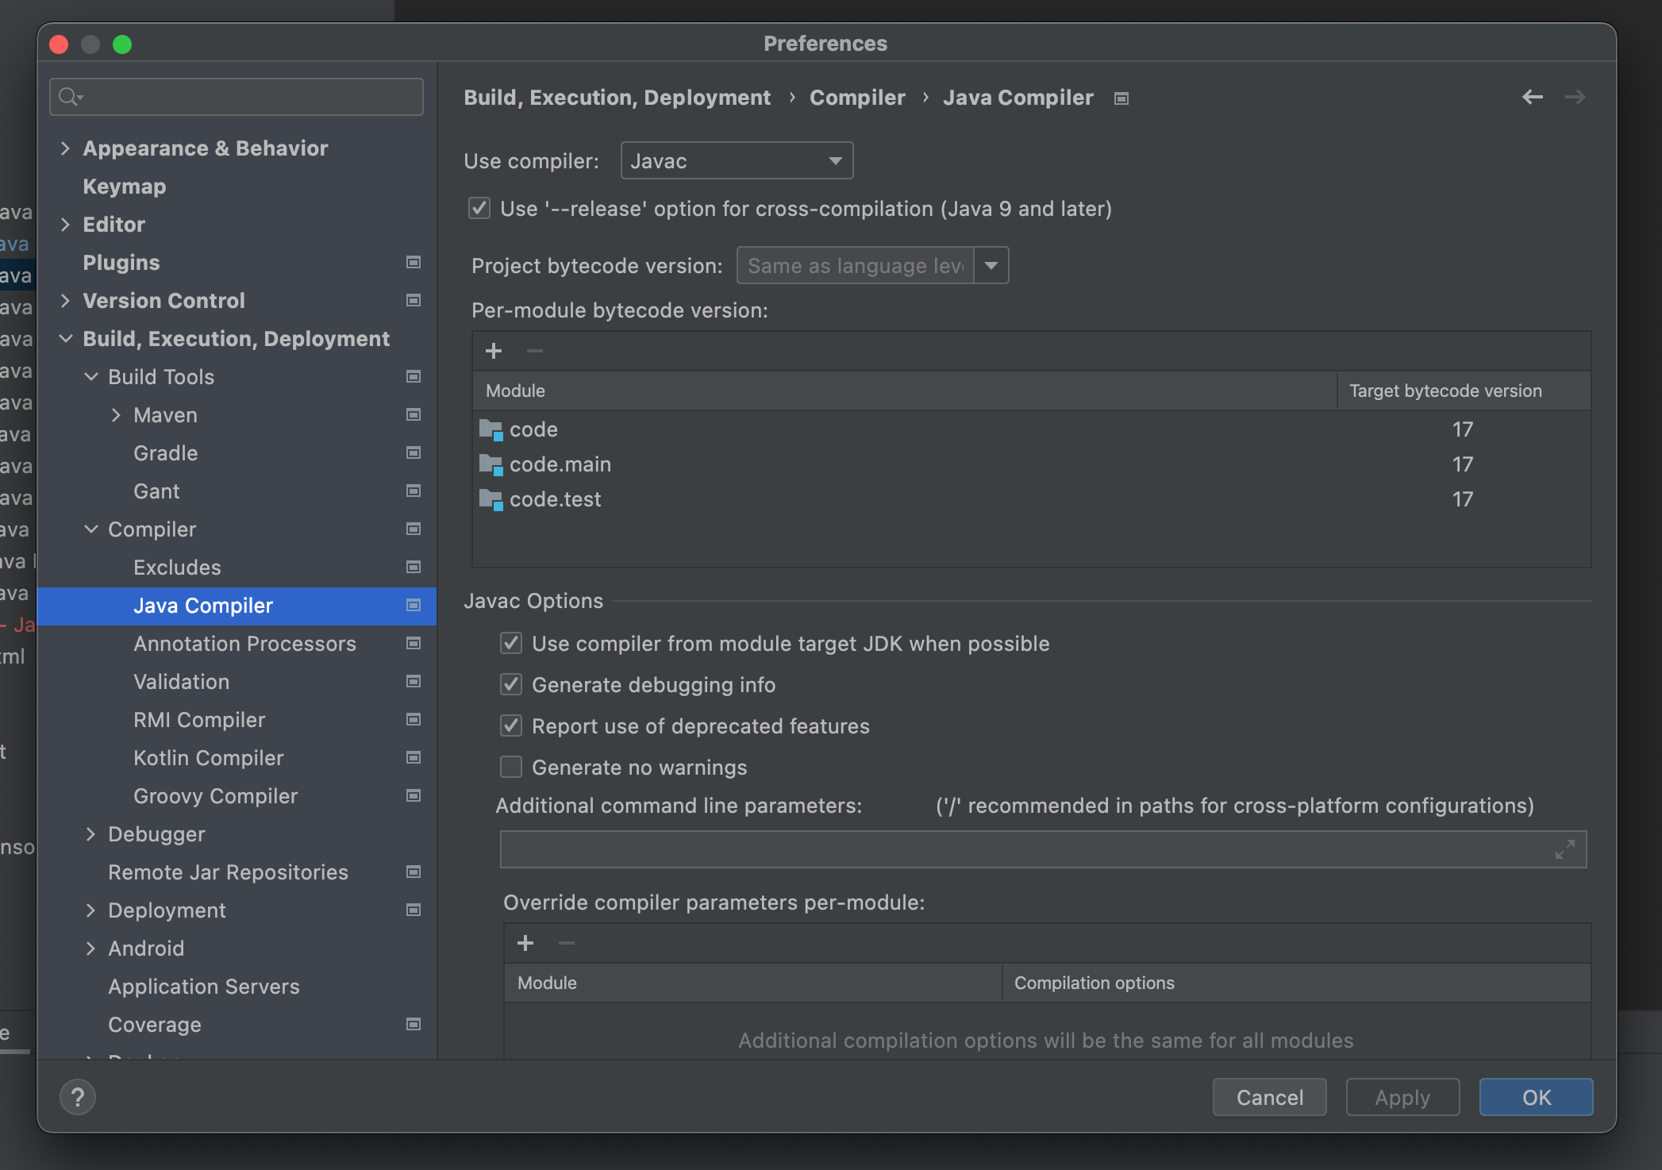
Preferences -> Build, Execution, Deployment -> Java Compiler
Use compiler: Javac
Target bytecode version: 17

Slide 16
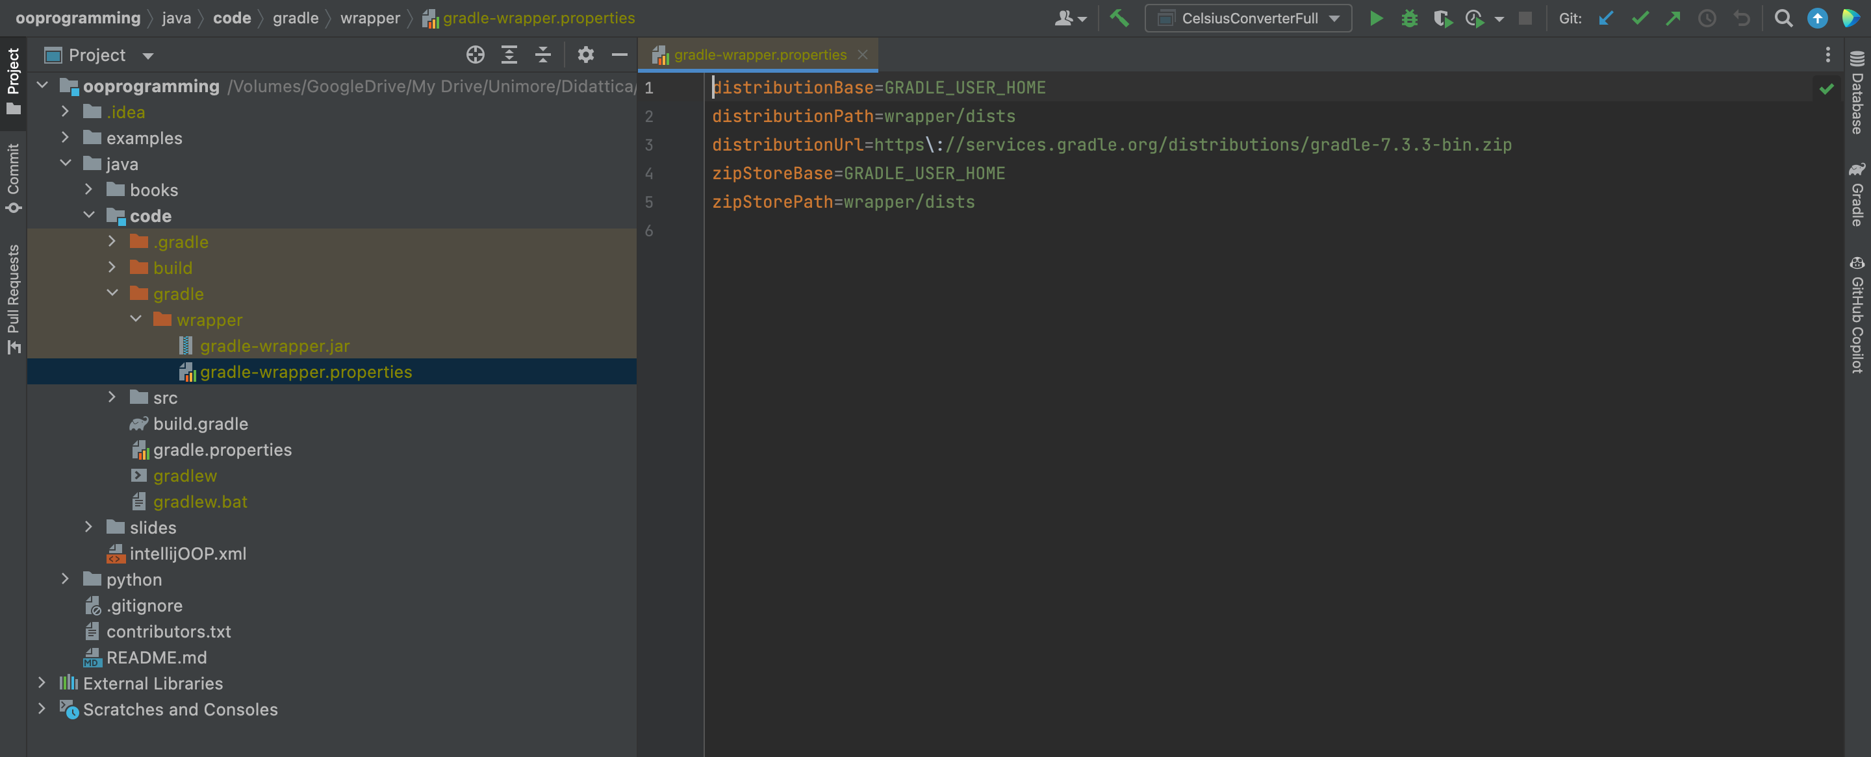
Preferences -> Build, Execution, Deployment -> Java Compiler

Slide 17
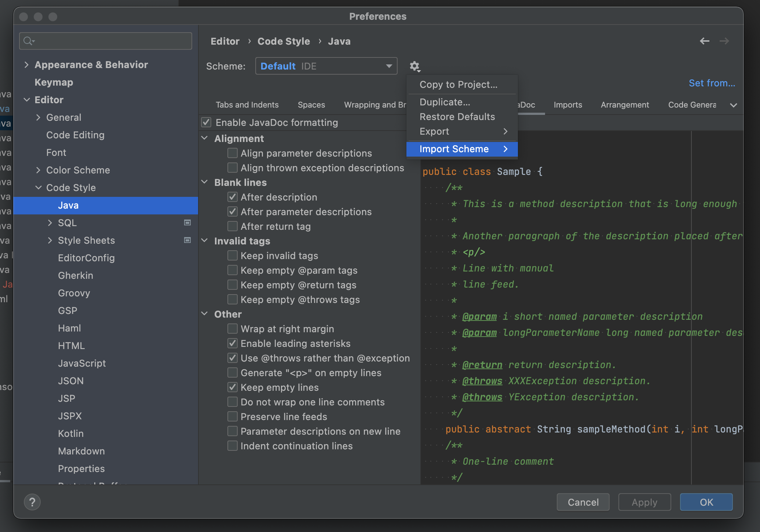
Preferences -> Editor -> Code Style -> Java
Import intellijOOP.xml (located in ooprogramming/java)

Slide 18
Variables, conventions, main method

Slide 19
Methods
Methods are blocks of code with a name which run when they are called
Methods are basically functions contained within a class
Methods receive parameters and return values
Java programs always start from a call to the public static void main(String[] args) method
public class Test {
public static long myMethod(int n) {
return n * n;
}
public static void main(String[] args) {
long n = myMethod(20);
System.out.println(n);
}
}
// Outputs: 400

Slide 20
Primitive types
public class PrimitiveTypes { public static void main(String[] args) { byte a = 13;
/* char is actually a 16 bit unsigned int */ char b = 65; short c = 34; int d = 332; long e = 122; float f = 7.6F; double g = 12.3; boolean h = true; } }

Slide 21
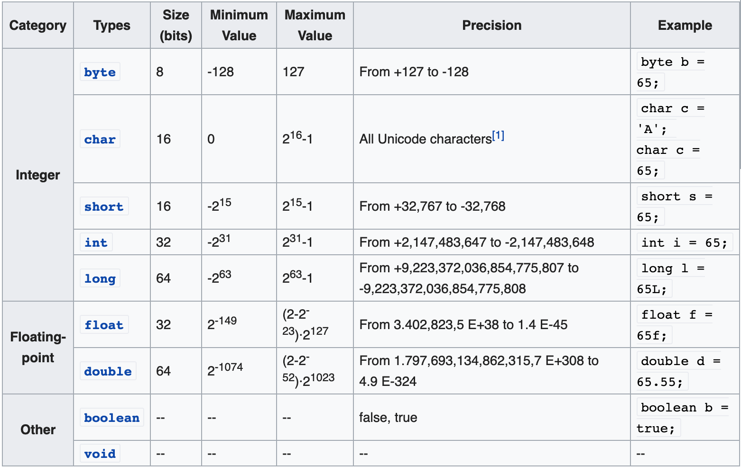
Primitive types

Slide 22
Constants
A constant is a variable whose value cannot change once it has been assigned.
A constant can make our program more easily read and understood by others. In addition, a constant is cached by the JVM as well as our application, so using a constant can improve performance.
To define a variable as a constant, we need to add the keyword final in front of the variable declaration.
final float PI = 3.1415F;
PI = 3.18; // ERROR, no changes allowed

Slide 23
Operators (integer and floating-point)
Operators follow C syntax:
arithmetical + - * / %
Relational == != > < >= <=
bitwise & | ^ ! >> <<
Logical && || ! ^
Assignment = += -= *= /= %= &= |= ^=
Increment ++ --
Chars can be treated as integers (e.g. switch)
Logical operators work ONLY on booleans. int is NOT considered a boolean value like in C

Slide 24
Code blocks and Scope
Java code blocks are the same as in C
Each block is enclosed by braces { } and starts a new scope for the variables
Variables can be declared everywhere within the scope
for (int i=0; i<10; i++){
int x = 12; ... int y;
...
}

Slide 25
Coding Conventions
class ClassName {
final double PI = 3.14;
private int attributeName;
public void methodName {
int var;
if (var == 0) {
/* this is a comment*/
}
}
}
In IntelliJ: Code -> Reformat File…

Slide 26
Passing Parameters
Parameters are always passed by value (copy)
Parameters can be primitive types or object references
Note well: only the object reference is copied not the value of the object

Slide 27
Passing Parameters
public class Parameters {
public static void main(String[] args) {
Point p1 = new Point(0, 0);
Point p2 = new Point(10, 10);
System.out.println(p1);
System.out.println(p2);
swap(p1, p2);
System.out.println(p1); // 0, 0
System.out.println(p2); // 10, 10
}
public static void swap(Point p1, Point p2) {
Point tmp = p1;
p1 = p2;
p2 = tmp;
}
}
main()
heap
swap()
p1
(0, 0)
p1
p2
(10, 10)
p2

Slide 28
Passing Parameters
public class Parameters {
public static void main(String[] args) {
Point p1 = new Point(0, 0);
Point p2 = new Point(10, 10);
System.out.println(p1);
System.out.println(p2);
move(p1, p2);
System.out.println(p1); // 10, 10
System.out.println(p2); // 0, 0
}
public static void move(Point p1, Point p2) {
p1.move(10, 10);
p2.move(0, 0);
}
}
main()
heap
move()
p1
(0, 0)
p1
p2
(10, 10)
p2

Slide 29
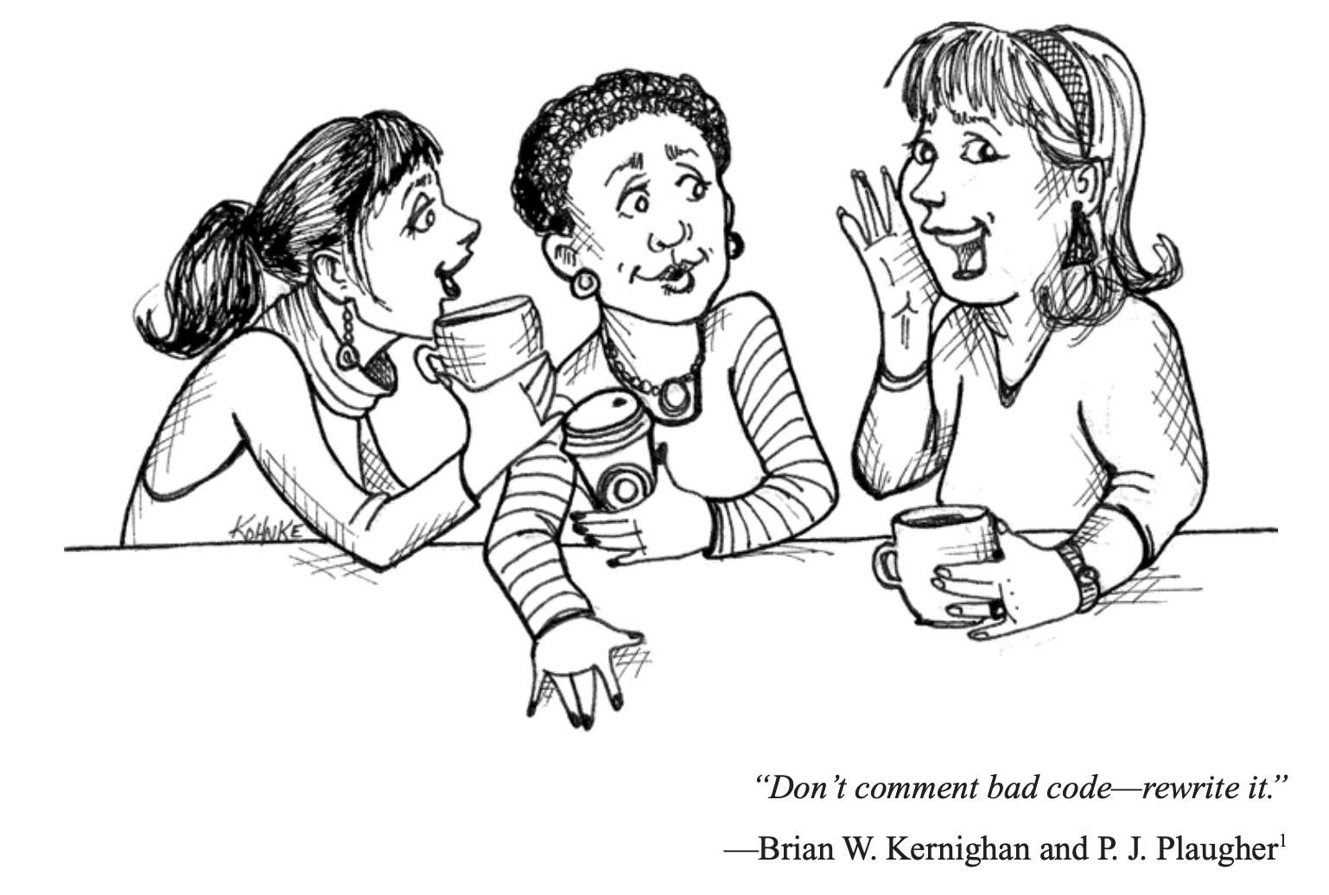
Comments
Multi-lines comments
/*
* this comment is so long
* that it needs two lines
*/
Single-line comments
// comment on one line

Slide 30
Flow control statements

Slide 31
Flow control statements
Decision making statements
if statements
switch statement
Loop statements
do-while loop
while loop
for loop
for-each loop
Jump statements
break statement
continue statement

Slide 32
if statement
# Syntax
if (condition1) {
// executed if
// condition1 is true
} else if (condition2) {
// executed if
// condition1 is false and condition2 is true
} else {
// executed if
// condition1 is false and condition2 is false
}
# Example
int time = 22;
if (time < 10) {
System.out.println("Good morning.");
} else if (time < 20) {
System.out.println("Good day.");
} else {
System.out.println("Good evening.");
}

Slide 33
switch statement
# Syntax
switch(expression) {
case x:
// code block
break;
case y:
// code block
break;
default:
// code block
}
# Example
char grade = ‘A’;
switch(grade) {
case 'A’ :
System.out.println("Excellent!");
break;
case 'B' :
case 'C' :
System.out.println("Well done");
break;
case 'D' :
System.out.println("You passed");
default :
System.out.println("Invalid grade");
}

Slide 34
do-while statement
# Syntax
do {
// code block to be executed
} while (condition);
# Example
int i = 0;
do {
System.out.println(i);
i++;
}
while (i < 5);

Slide 35
while statement
# Syntax
while (condition) {
// code block to be executed
}
# Example
int i = 0;
while (i < 5) {
System.out.println(i);
i++;
}

Slide 36
for statement
# Syntax (traditional)
for (statement 1; statement 2; statement 3) {
// code block to be executed
}
# Syntax (for-each)
for (type variableName : arrayName) {
// code block to be executed
}
# Example (traditional)
for (int i = 0; i <= 10; i++) {
System.out.println(i);
}
# Example (for-each)
String[] cars = {"Supra", "Lancer", "Impreza"};
for (String i : cars) {
System.out.println(i);
}

Slide 37
break/continue statements
The break statement can be used to jump out of a loop.
The continue statement breaks one iteration (in the loop), if a specified condition occurs, and continues with the next iteration in the loop.
# Example (break)
for (int i = 0; i < 10; i++) {
if (i == 4) {
break;
}
System.out.println(i);
}
# Example (continue)
for (int i = 0; i < 10; i++) {
if (i == 4) {
continue;
}
System.out.println(i);
}

Slide 38
References and Objects

Slide 39
References and Objects
A reference is an entity which provides a way to access objects of its type.
An object is an entity which provides a way to access the members of it's class or type.
Generally, You can't access an object without a reference to it.
class Point {
void move() {
// some business logic.
}
}
Without Reference:
new Point().move();
// you can't reuse the object
// bad way to code.
With Reference:
Point p = new Point();
p.move();
// Now, the object can be reused.
// Preferred way to code

Slide 40
References and Objects
# C
typedef struct point { float x; float y; } point_t; point_t *allocate_point(float x, float y) { point_t *p = malloc(sizeof(point_t)); p->x = x; p->y = y; return p; } void free_point(point_t *p) { free(p); }
int main() { point_t *p = allocate_point(2, 3); printf("(%f,%f)\n", p->x, p->y);
free_point(p); }
# Java
public class Point { int x; int y; public Point(int x, int y) { this.x = x; this.y = y; } }
Public class Application {
public static void main(String[] args) { Point p = new Point(2, 3); System.out.printf("(%d, %d)\n", p.x, p.y); }
}

Slide 41
References and Objects
Objects resides in heap memory. Their life do not depend on the life of the method they have been created in.
public class Test { public static Point allocatePoint(int x, int y) { return new Point(x, y); } public static void main(String[] args) { Point p = allocatePoint(2, 3); System.out.println(p); } }

Slide 42
Array

Slide 43
Array
An array is an ordered sequence of variables of the same type which are accessed through an index
Can contain both primitive types or object references (not the actual objects!)
Array size must be defined at creation time (cannot change afterwards)
An array reference can be declared with one of these equivalent syntaxes
int[] v or int v[]
Point[] v or Point v[]
Declaration is not creation!
// declaration
int[] v;
int[] v = null;
// declaration and creation
int[] v = new int[256];
int[] v = {2,3,5,7,11,13};

Slide 44
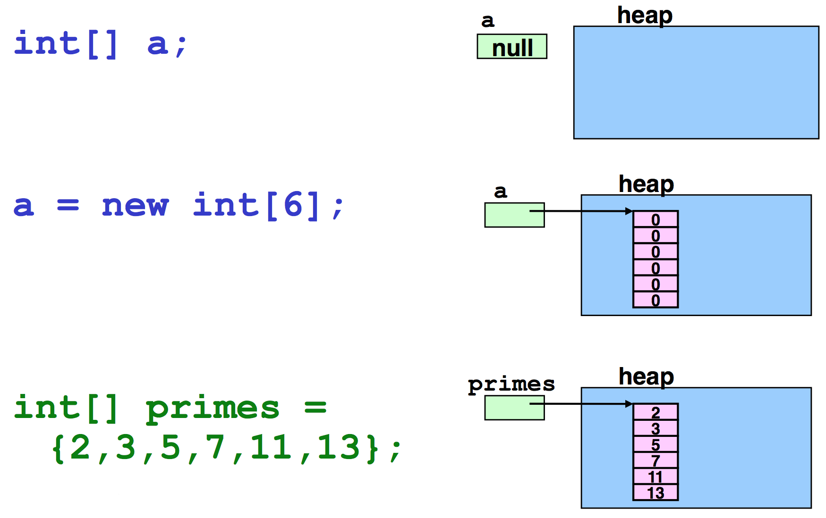
Example – Primitive types

Slide 45
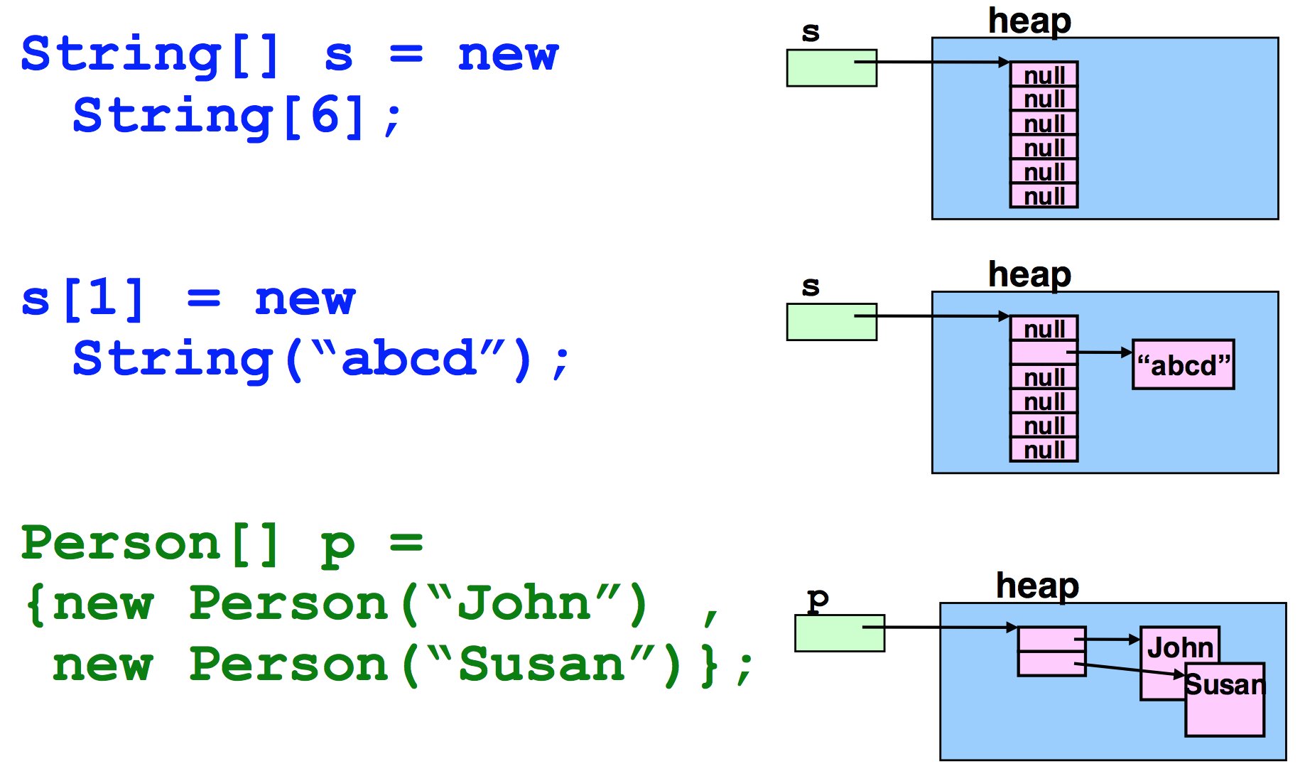
Example – Object reference

Slide 46
Operations on arrays
String[] args;
/* explicit index */
for(int i = 0; i < args.length; i++) {
System.out.println(args[i]); //...
}
/* implicit index
(also called for-each syntax) */
for(String arg: args) {
System.out.println(arg);
//...
}
Java checks array bounds at runtime
int[] v = new int[16]
System.out.println(v[20])
ArrayIndexOutOfBoundsException
The length of an array (the maximum capacity of the array) is provided by the attribute length.
Not to be confused with the method size() provided by the Collection interface!

Slide 47
Operations on arrays
An array reference is not a pointer to the first element of the array
It is a reference to the array object
Arithmetic on pointers does not exist in Java
// error!
int[] v1 = new int[16]; int[] v2 = v1 + 2;

Slide 48
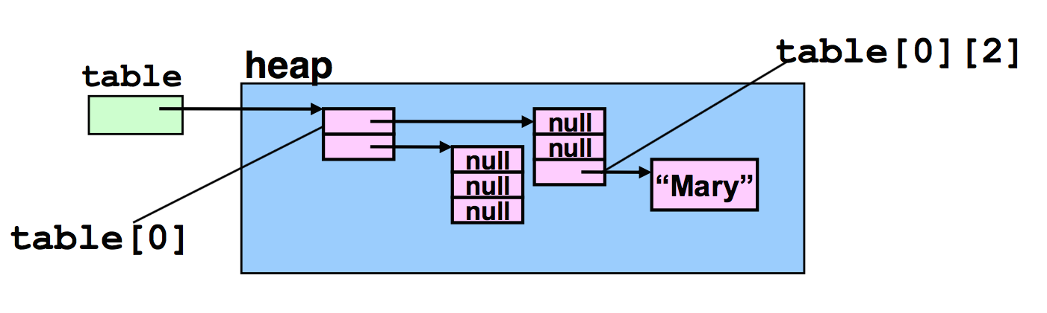
Multidimensional Arrays
String[][] table = {{"a", "b", "c"}, {"d", "e", "f"}}; System.out.println(Arrays.deepToString(table)); // switching rows only requires switching references
String[] tmp = table[0]; table[0] = table[1]; table[1] = tmp; System.out.println(Arrays.deepToString(table)); }

Slide 49
java.util.Arrays
Alter-ego of java.util.Collections for arrays
This class contains various methods for manipulating arrays such as sorting, searching, filling, printing or being viewed as Collections
binarySearch()
sort()
fill()
toString()
asList()

Slide 50
System.arraycopy()
System.arraycopy() copies an array from the specified source array, beginning at the specified position, to the specified position of the destination array. The number of components copied is equal to the length argument.
Advised because simple and fast!
public static void arraycopy(
Object src, int srcPos,
Object dest, int destPos,
int length)

Slide 51
Example
public static void main(String[] main) {
Random rnd = new Random();
int[] v1 = new int[10];
int[] v2 = new int[10];
Arrays.fill(v1, 15);
System.out.println("v1 = " + Arrays.toString(v1));
for (int i = 0; i < v1.length; i++) {
v1[i] = rnd.nextInt(100);
}
System.out.println("v1 = " + Arrays.toString(v1));
Arrays.sort(v1);
System.out.println("v1 = " + Arrays.toString(v1));
System.arraycopy(v1, 0, v2, 0, 10);
System.out.println("v2 = " + Arrays.toString(v2));
}
v1 = [15, 15, 15, 15, 15, 15, 15, 15, 15, 15]
v1 = [37, 48, 19, 66, 18, 41, 8, 35, 44, 16]
v1 = [8, 16, 18, 19, 35, 37, 41, 44, 48, 66]
v2 = [8, 16, 18, 19, 35, 37, 41, 44, 48, 66]

Slide 52
Strings

Slide 53
String
C (char[] == string)
char s[] = “literal”;
Java (char[] != string)
More specifically, in Java, Strings are instances (objects) of a specific class (java.lang.String)
char[] s = {'h','e','l','l','o’};
String s = new String(“Hello”);
String s = “hello”;

Slide 54
Strings in memory
Strings are immutable in Java
Being immutable, when we create a String variable and assign a value to it, the JVM can optimize the amount of memory allocated by storing only one copy of each literal String
String first = "Baeldung"; // memory use
String second = "Baeldung"; // no actual memory use
System.out.println(first == second); // True

Slide 55
Strings in memory
If we call the constructor of the class using the new operator, Strings are stored in memory (heap) as standard objects.
String first = new String("Baeldung"); // memory use
String second = new String("Baeldung"); // memory use
String third = "Baeldung"; // memory use
System.out.println(first == second); // False
System.out.println(first == third); // False

Slide 56
equals vs ==
The == operator verifies if two references point to the same object
The equals() method, instead, verifies if two objects (any object!) have the same internal state
String s1 = “hello”;
String s2 = ”hello”;
// true! Same object!
if (s1 == s2) { . . . }
// true
if (s1.equals(s2)) { . . . }
String s1 = new String(“hello”);
String s2 = new String(”hello”);
// false! Different objects!
if (s1 == s2) { . . . }
// true
if (s1.equals(s2)) { . . . }

Slide 57
String methods
charAt() Returns the character at the specified index (position)
compareTo() Compares two strings lexicographically
concat() Appends a string to the end of another string
contains() Checks whether a string contains a sequence of characters
endsWith() Checks whether a string ends with the specified character(s)
isEmpty() Checks whether a string is empty or not
length() Returns the length of a specified string
replace() Searches a string for a specified value, and returns a new string where the specified values are replaced
split() Splits a string into an array of substrings
startsWith() Checks whether a string starts with specified characters
substring() Returns a new string which is the substring of a specified string
valueOf() Returns the string representation of the specified value

Slide 58
The + operator
It is used to concatenate 2 strings
String s = “This string” + “is made by two strings”
Works also with other types (automatically converted to string)
System.out.println(“pi = ” + 3.14);
System.out.println(“x = ” + x);

Slide 59
StringBuilder
Strings are immutable. When two Strings are concatenated using +, the two Strings are actually discarded and a new one (containing their concatenation) is instantiated.
This process is slow
StringBuilder provides a better way
public static void main(String[] args) {
// slow version
String s = "";
for (int i = 0; i < 100; i++) {
s += 'a';
}
System.out.println(s);
// fast version using StringBuilder
StringBuilder sb = new StringBuilder();
for (int i = 0; i < 100; i++) {
sb.append('a');
}
System.out.println(sb.toString());
}

Slide 60
Accessing Terminal

Slide 61
Standard files
System.in is an InputStream which is typically connected to keyboard input of console programs.
System.out is a PrintStream to which you can write characters. It normally outputs the data you write to it to the console / terminal.
System.err is a PrintStream. It works like System.out except it is normally only used to output error texts. Some programs (like Eclipse) will show the output to System.err in red text, to make it more obvious that it is error text.

Slide 62
PrintStream Methods
void print(String s)
Prints a string
void println(String s)
Prints a String and then terminate the line
void printf(String format, Object... args)
Write a formatted string using the specified format string and arguments
String String.format(String format, Object... args)
Returns a formatted string using the specified format string and arguments

Slide 63
Scanner
Scanner is a text scanner which can parse primitive types and strings using regular expressions.
Scanner breaks its input into tokens using a delimiter pattern, which by default matches whitespace.
The resulting tokens may then be converted into values of different types using the various next methods.
/* from stdin */
Scanner sc = new Scanner(System.in);
int i = sc.nextInt();
/* from a file */
Scanner sc = new Scanner(
new File("myNumbers"));
while (sc.hasNextLong()) {
long aLong = sc.nextLong();
}
/* using regular expressions */
String input = "1 fish 2 fish red fish blue fish";
Scanner s = new Scanner(input).useDelimiter("\\s*fish\\s*"); System.out.println(s.nextInt()); System.out.println(s.nextInt()); System.out.println(s.next());
System.out.println(s.next());
s.close();

Slide 64
Random Numbers

Slide 65
Random numbers
Math.random()
java.util.Random
Random random = new Random();
random.nextInt() [MIN_VALUE, MAX_VALUE]
random.nextDouble() [0, 1]
random.nextBoolean() [true, false]
java.util.concurrent.ThreadLocalRandom
ThreadLocalRandom.current().nextInt()
ThreadLocalRandom.current().nextDouble()
ThreadLocalRandom.current().nextBoolean()

Slide 66
Wisdom Pills
The first rule of functions is that they should be small. The second rule of functions is that they should be smaller than that. This is not an assertion that I can justify. I can’t provide any references to research that shows that very small functions are better. What I can tell you is that for nearly four decades I have written functions of all different sizes. I’ve writ- ten several nasty 3,000-line abominations. I’ve written scads of functions in the 100 to 300 line range. And I’ve written functions that were 20 to 30 lines long. What this experience has taught me, through long trial and error, is that functions should be very small. -- Clean Code, Robert C. Martin

